Slide 1
Using ML Techniques to Better Predict Inflation
Caden Finley

Slide 2
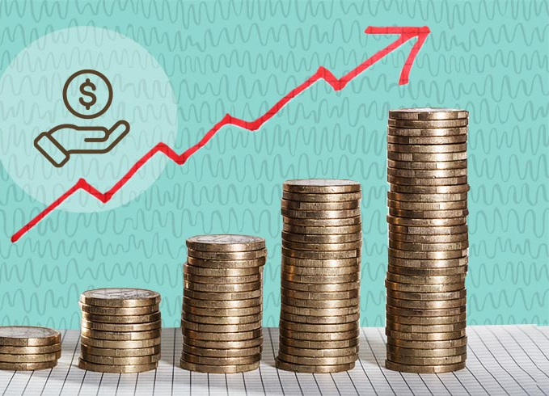
Introduction
Consumer Price Index (CPI) and Inflation
Macro-level effects
Forecasting time series Data in R with Machine Learning
Techniques to better predict

Slide 3

Literature Review
Paper by Volkan Ulke discusses ideas of time series and ML for forecasting interest rates
Multivariate model
Shows machine learning models prevails against time series models for the core personal consumption expenditure (PCE) inflation forecasting, and the time series mode) is better for the core consumer price (CPI) index inflation

Slide 4
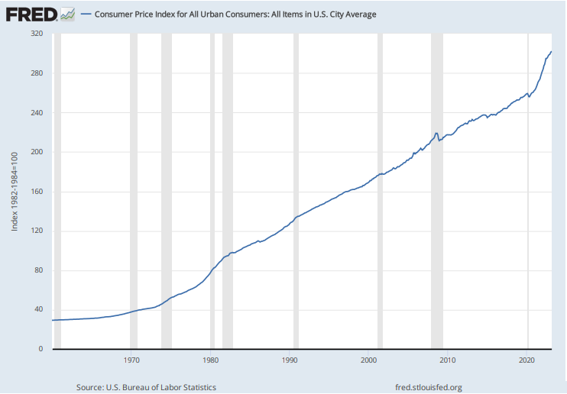
API Key
Web Scraping
Same results for reliably replicating
Index represents consumer spending over time
1980 when level hit 100 and became baseline
Currently over 300 on index

Slide 5
Future forecasted direction
Auto-Regressive Integrated Moving Average (ARIMA) Model
Time series to predict future direction of inflation
Linear

Slide 6
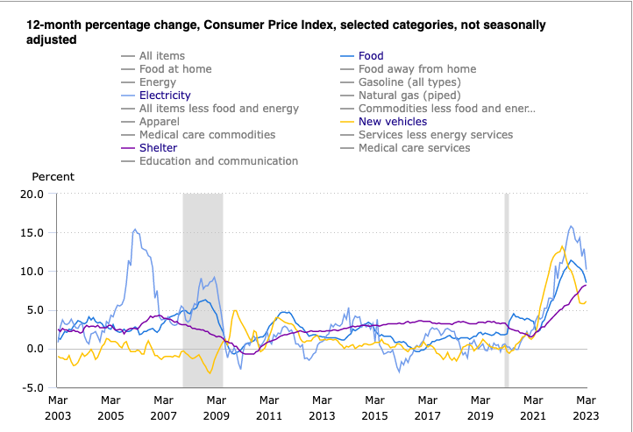
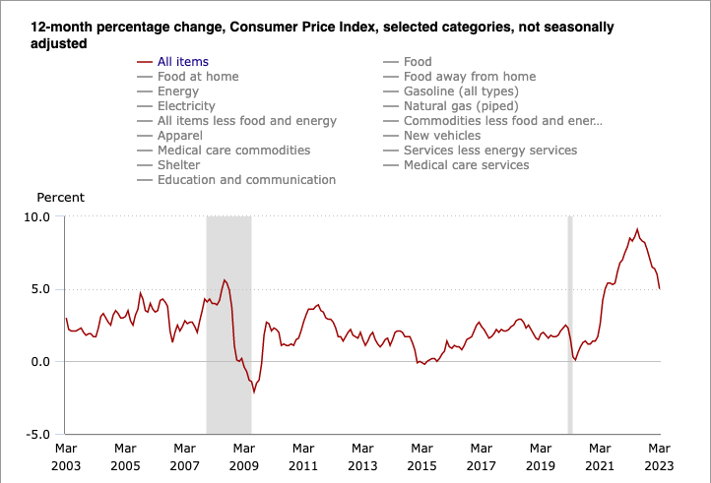
Vector Autoregressive Model (VAR)
Different Weights to Goods/Services
Reveals importance of potential inflation bias

Slide 7
Conclusion
Inflation is a key metric that influences purchasing power of consumers and corporations
Important to be aware of price changes because they effect everyday life
Be aware of potentially misleading data in CPI

Slide 8
Works Cited
Diebold, F.X., & Li, C. (2002). Forecasting the Term Structure of Government Bond Yields. Econometrics eJournal.
Wynne, M.A., & Sigalla, F.D. (1994). The consumer price index. Economic and Financial Policy Review, 1-22.
Barro, R.J. (1995). Inflation and Economic Growth. NBER Working Paper Series.
Ülke, V., Sahin, A., & Subasi, A. (2016). A comparison of time series and machine learning models for inflation forecasting: empirical evidence from the USA. Neural Computing and Applications, 30, 1519 - 1527.

